Slide 1
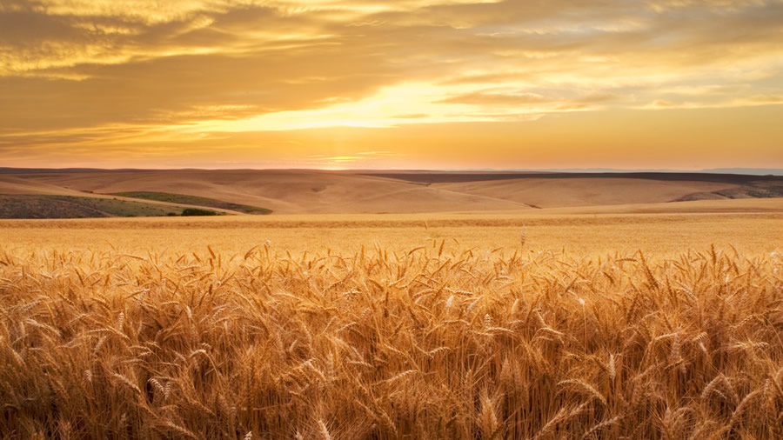
The first mission trip
Mark 6:7-30

Slide 2
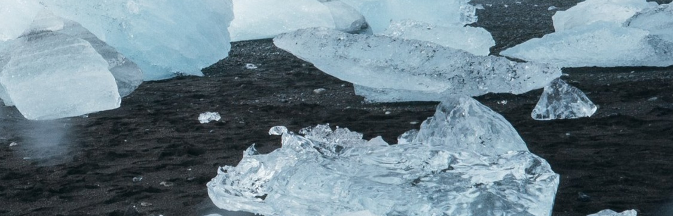
ICebreaker

Slide 3
Preparation
When was the last time you were challenged?
How did you prepare for that challenging event?
When did you know you were ready?
Were you really ready?

Slide 4
Mark 6:7-13
Jesus Sends out the 12

Slide 5
Mark 6:7-13 Jesus Sends out the 12
Then Jesus went around teaching from village to village. Calling the Twelve to him, he began to send them out two by two and gave them authority over impure spirits.
These were his instructions: “Take nothing for the journey except a staff—no bread, no bag, no money in your belts. Wear sandals but not an extra shirt. Whenever you enter a house, stay there until you leave that town. And if any place will not welcome you or listen to you, leave that place and shake the dust off your feet as a testimony against them.”
They went out and preached that people should repent. They drove out many demons and anointed many sick people with oil and healed them.

Slide 6
Mark 6:6-7
6 Then Jesus went around teaching from village to village. 7 Calling the Twelve to him, he began to send them out two by two and gave them authority over impure spirits.
“The Twelve”: remember who these guys are. What were their qualifications?
“to send”: apostellein (Greek) Verb form of the word apostle in Mark 3:14.
Why two by two?
Why did Jesus give the apostles authority over impure spirits?
Notes:
“The 12”: these guys have only been with Jesus a short time. They were nothing special.
God Calls us in order to Send us! Next slide
Deut 17:6 “ On the testimony of two witnesses” Paul doubles down in 2 Corinthians 13:1
What is the point of miracles. “Authenticate the Authority of the messenger” or Validate the Message. Reflect on Moses in Ex 4.

Slide 7
Mark 3:13-15
And he went up on the mountain and called to him those whom he desired, and they came to him. And he appointed twelve (whom he also named apostles) so that they might be with him and he might send them out to preach and have authority to cast out demons.
Matthew 11:28-30
“Come to me, all you who are weary and burdened, and I will give you rest. Take my yoke upon you and learn from me, for I am gentle and humble in heart, and you will find rest for your souls. For my yoke is easy and my burden is light.”
Notes:
Many people just want to come to Jesus. They are not willing to take His yoke and get to work.

Slide 8
The Highs previous miracles in mark
The Low
Lack of Miracles in Hometown
Demons & Healings in Capernaum (Chapter 1)
Paralytic in Chapter 2
Paralyzed hand in Chapter 3
Calmed the Seas Chapter 4
Demoniac in Chapter 5
Healed the hemorrhaging woman in Chapter 5
Raised the Dead in Chapter 5
Mark 6
4 Jesus said to them, “A prophet is not without honor except in his own town, among his relatives and in his own home.” 5 He could not do any miracles there, except lay his hands on a few sick people and heal them. 6 He was amazed at their lack of faith.
Question: Why do you think Jesus waited until after they had met resistance (failure) before sending them out on their own?
Notes:
Talk about timing.

Slide 9
Mark 6:8-10
These were his instructions: “Take nothing for the journey except a staff—no bread, no bag, no money in your belts. Wear sandals but not an extra shirt. Whenever you enter a house, stay there until you leave that town.
No staff??
No Bread or money??
No Bag??
No extra shirt??
Stay at the same house the whole time??
It’s all about preparation.
Luke 22: 35 Then Jesus asked them, “When I sent you without purse, bag or sandals, did you lack anything?” “Nothing,” they answered.
Notes:
No staff could mean relying on God for protection
No bread meant they would need to immediately find assistance.
No bag meant they were not supposed to take an offering.
No money meant they had to continually rely on God.
No extra shirt meant they were supposed to find dwelling and not sleep out under the stars.
Same house meant they needed to be content. No upgrades.

Slide 10
Mark 6:8 vs Luke 9:3 vs Matt 10:2
Mark: These were his instructions: Take nothing for the journey except a staff—no bread, no bag, no money in your belts. Wear sandals but not an extra shirt.
Luke: He told them: Take nothing for the journey—no staff, no bag, no bread, no money, no extra shirt.
Matthew: Do not get any gold or silver or copper to take with you in your belts— no bag for the journey or extra shirt or sandals or a staff, for the worker is worth his keep.
Staff or No Staff?
This could be three separate events.
This could be the same event, but an issue with understanding the emphasis when translating from Hebrew to Greek to English.
The Greek verbs connected are close but slightly different.

Slide 11
Mark 6:11
And if any place will not welcome you or listen to you, leave that place and shake the dust off your feet as a testimony against them.”
“Shake the dust” – cultural context
Similar to “casting pearls before swine”.
How do you know when to move on?
Notes:
Religious elites would shake their feet off before returning from pagan lands.
Symbolizes that that city is not part of the true Kingdom of God
When hostility is sure to be returned.

Slide 12
Mark 6:12-13
They went out and preached that people should repent. They drove out many demons and anointed many sick people with oil and healed them.
The apostles obeyed!

Slide 13
Mark 6:14-20
King Herod heard about this, for Jesus’ name had become well known. Some were saying, “John the Baptist has been raised from the dead, and that is why miraculous powers are at work in him.” Others said, “He is Elijah.” And still others claimed, “He is a prophet, like one of the prophets of long ago.” But when Herod heard this, he said, “John, whom I beheaded, has been raised from the dead!” For Herod himself had given orders to have John arrested, and he had him bound and put in prison. He did this because of Herodias, his brother Philip’s wife, whom he had married. For John had been saying to Herod, “It is not lawful for you to have your brother’s wife.” So Herodias nursed a grudge against John and wanted to kill him. But she was not able to, because Herod feared John and protected him, knowing him to be a righteous and holy man. When Herod heard John, he was greatly puzzled; yet he liked to listen to him.

Slide 14
Mark 6:21-29
Finally the opportune time came. On his birthday Herod gave a banquet for his high officials and military commanders and the leading men of Galilee. When the daughter of Herodias came in and danced, she pleased Herod and his dinner guests. The king said to the girl, “Ask me for anything you want, and I’ll give it to you.” And he promised her with an oath, “Whatever you ask I will give you, up to half my kingdom.” She went out and said to her mother, “What shall I ask for?” “The head of John the Baptist,” she answered. At once the girl hurried in to the king with the request: “I want you to give me right now the head of John the Baptist on a platter.” The king was greatly distressed, but because of his oaths and his dinner guests, he did not want to refuse her. So he immediately sent an executioner with orders to bring John’s head. The man went, beheaded John in the prison, and brought back his head on a platter. He presented it to the girl, and she gave it to her mother. On hearing of this, John’s disciples came and took his body and laid it in a tomb.

Slide 15
Mark 6:30
³⁰ The apostles gathered around Jesus and reported to him all they had done and taught.

Slide 16
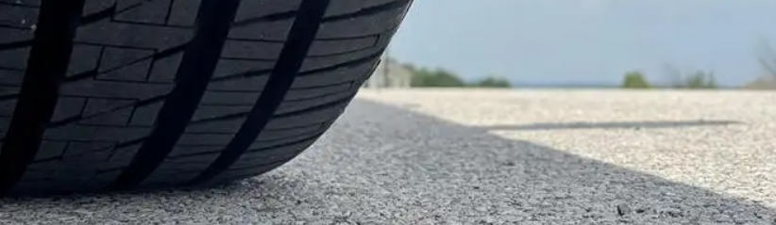
Application – Prescriptive or Descriptive

Slide 17
What is God Prescribing we do today?
Should we wait until we have a partner before we witness to anyone?
Should we not raise money or make preparation before we go on missions?
Do we have to stay at someone’s home when we go on missions?
Do we have to do miracles for our message to be validated?
Should we expect to be rejected by some?
Should we rely on God to provide where he has called us?
What has God prepared you for? How are you obeying?
Notes:
Remember: the apostles only knew Jesus for a short time.

Slide 18

Up Next
7/14 Rhett Mark 6:31-44
7/21 Josh Mark 7:1-23
7/28 Rhett Mark 7:24-37
8/4 Rhett Mark 8:1-26

